Slide 1
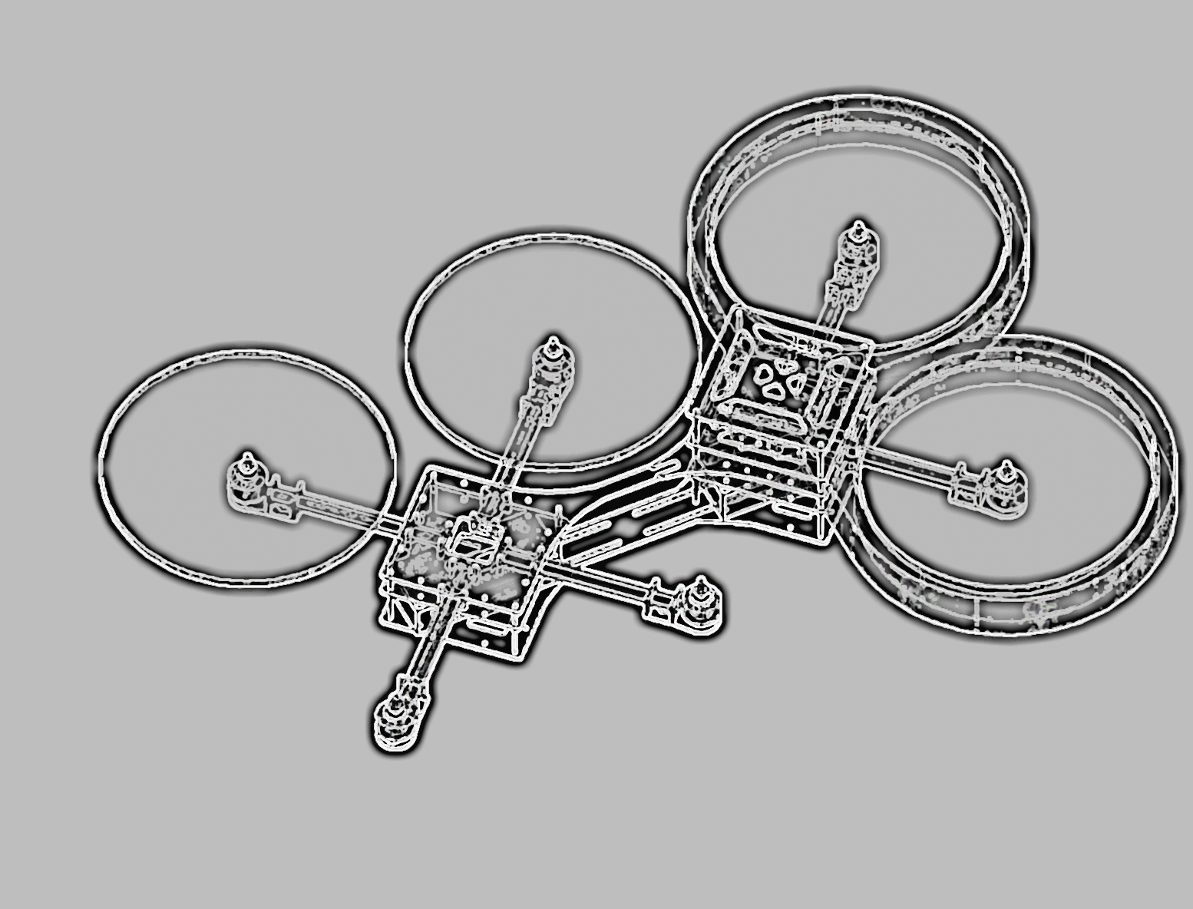
Integrated Project
X-COPTER

Slide 2

The X-Copter Project: Hardware
University of
Applied Sciences
Additional Flight controller Hardware
Commercial powersupply
- 5-30 Vin
- 5-12Vout
- max 6A output
Graupner MX-16 RC transmitter
Gr-16 2.4 GHz RC receiver

Slide 3
The X-Copter Project: Hardware
University of
Applied Sciences
RC Receiver
Graupner MX-16 HoTT Transmitter
GR-16 2.4 GHz Receiver supporting
- Sum signal (PPM)
- Serial sum signal
Support for telemetry data

Slide 4
The X-Copter Project: Hardware
University of
Applied Sciences
Graupner SUMD protocol
Compatible with UART port
Updating every 10ms
16bit output resolution
Fairly easy to implement
In contrast to PPM no realtime encding required.

